Slide 1
Building a Dao
Constructing Persistence Classes

Slide 2
Step 1) Model Your Table as a DTO
  A DAO relies on one thing – its corresponding DTO
  DTO stores information from a table
    It has a variable for each field in the table
    It has at least one constructor
      Need to be able to make an instance of the DTO
    It has getter methods for each variable (NO setter methods)
    It has a toString method
    It has an equals method
      Need to be able to compare two DTO instances (e.g. two Movies)
    It has a hashCode method
      Whenever you provide an equals method, you should also provide the corresponding hashCode method
  When writing DTO equals and hashCode methods, you should base the values used on the primary key of the corresponding table

Slide 3
Example Table
  CREATE TABLE users(
      name varchar (20) NOT NULL,
      password varchar (256) NOT NULL,
      PRIMARY KEY(name, password)
  );
Table names are usually PLURAL as they store multiple records of the type of information they hold

Slide 4
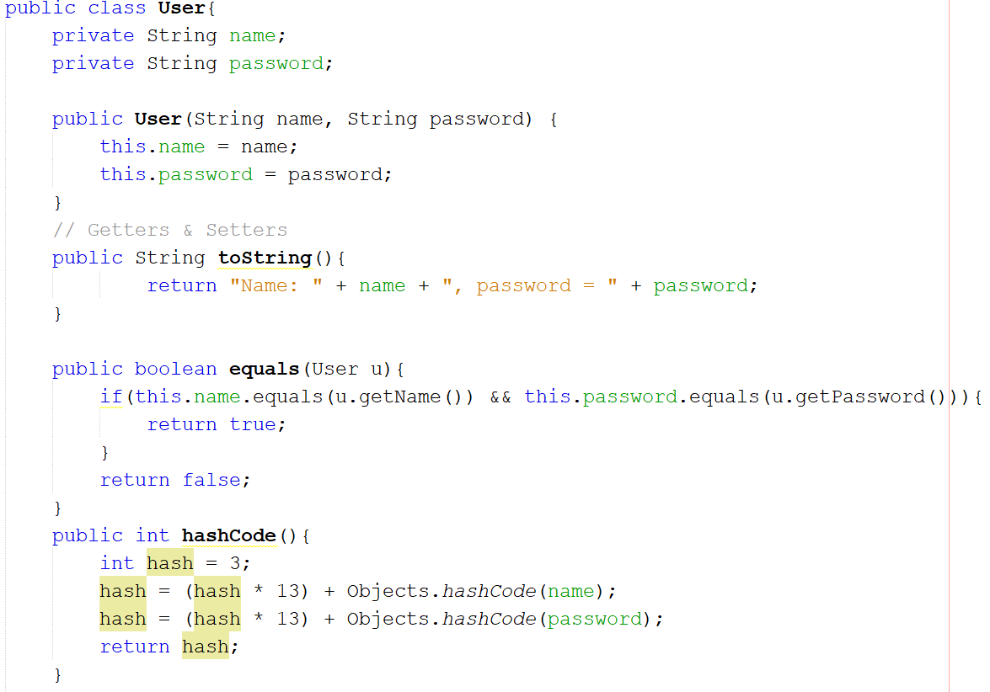
Example DTO – Modelling the User Table
DTO names are usually SINGULAR, as they store a single record of the type of information

Slide 5
Step 2) Provide Connections:
Make a Connection Object& Inject It
  DAOs access your database. To do this, they need to be able to connect.
    Need a way to open a connection to the database
    Need a way to close a connection to the database
  Connection class should have methods to do these things:
    getConnection() - this should get a connection to the database
    freeConnection() – this should close a connection to the database
  Connection class should implement a Connector interface to enhance flexibility
    Can use different implementations depending on the situation
  Dependency injection allows us to flexibly provide these abilities to all DAOs
    No need to rewrite/duplicate the code

Slide 6
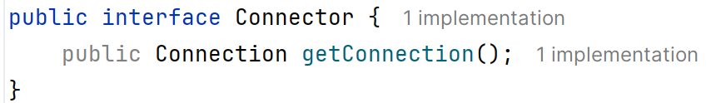
Example Connector Interface

Slide 7
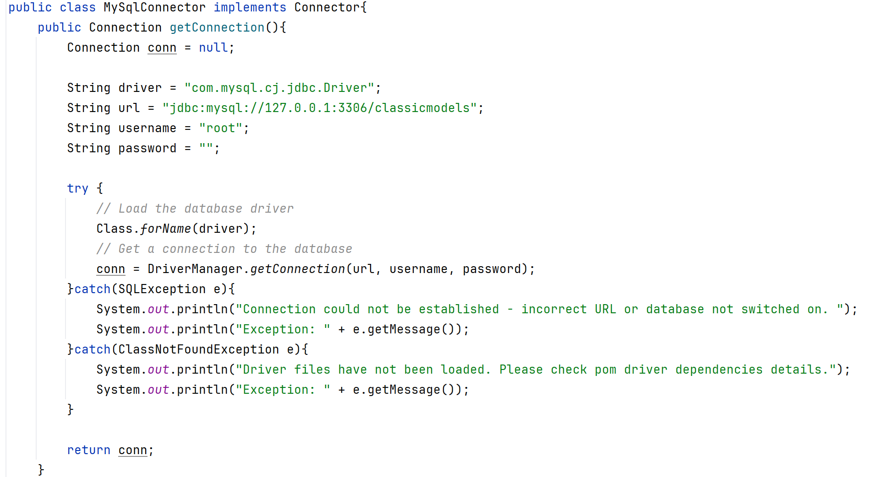
Example Connection Class and Interface

Slide 8
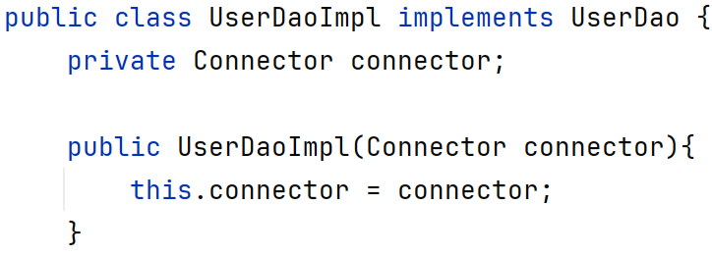
Example of Injecting Connector into DAO

Slide 9
Step 3) Decide on Your DAO’s Abilities: Create an Interface
  DAOs are all about abilities
    Get all users in the database
    Check if a user is in the database (login)
    Add a user to the database
    Remove a user from the database
  These abilities are all different methods specified within the DAO’s interface within that table-specific DAO.
    Interface gives an overview of what a DAO can do.

Slide 10
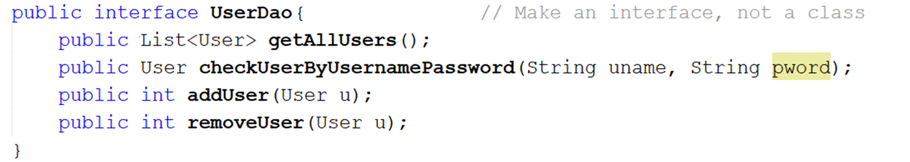
Example: The UserDao
  This contains all abilities the User Dao will possess – i.e. Everything it can do.
    Quicker to look at this than to look through the entire implementation class.
    If you make another implementation (e.g. UserDaoNoSQLImpl) that accesses a NoSQL database, you can force that version to also provide the same abilities with the same format.

Slide 11
Step 4) Build the DAO Implementation
  Each table in the database gets its own DAO
    Movie table has a Movie DAO
    User table has a User DAO
    Employee table has an Employee DAO
    Product table has a Product DAO
  Each table-specific DAO should only ever access the table it’s named for
    ProductDao ONLY queries the Product table
    OrderDao ONLY queries the Order table.
    If OrderDao needs Product info, it calls a method in the ProductDaoImpl class (no joins, no direct queries)
  A DAO should be named after the table it’s querying
    MovieDaoImpl
    UserDaoImpl
    EmployeeDaoImpl
    ProductDaoImpl
  Each DAO needs to be able to open a connection and close a connection to the database
    Inherit from/extend the Dao superclass

Slide 12
Example UserDaoImpl Shell
public class UserDaoImpl {
private Connector connector;
public UserDaoImpl(Connector c){
this.connector = c;
}
// Methods go here
}
Store instance of connector
Have it injected into the DAO

Slide 13
Step 5) Guarantee Abilities in Your DAO:
Connect Your DAO to Your Interface
  Your (table-specific) DAO implementation needs all the abilities you listed in the interface.
  You need to force the implementation to provide these specific abilities.
    Implementing the interface forces the DAO implementation to have the methods listed.

Slide 14
Example: UserDaoImpl Shell
public class UserDaoImpl implements UserDao {
private Connector connector;
public UserDaoImpl(Connector c){
this.connector = c;
}
// Methods go here
}
Implement interface to force UserDaoImpl to provide all abilities (methods) mentioned in UserDao
Store instance of connector
Have it injected into the DAO

Slide 15
Step 6) Give Your DAO Code For Each Ability
  For each line in your interface, write a method that does that action
  The method should:
    Get a connection to the database
    Create an SQL statement to do the thing the method is meant to do, E.g.
      Select all users
      Select the users that have the same username AND password as what’s supplied
      Insert a user’s information
      Remove a user’s information
    Execute that SQL statement
      executeQuery for select statements
      executeUpdate for insert, delete and update
    Save the results
      The number of rows updated for an executeUpdate (an insert/update/delete)
      One or more DTO objects for an executeQuery (a select)
    Return the results

